Slide 1
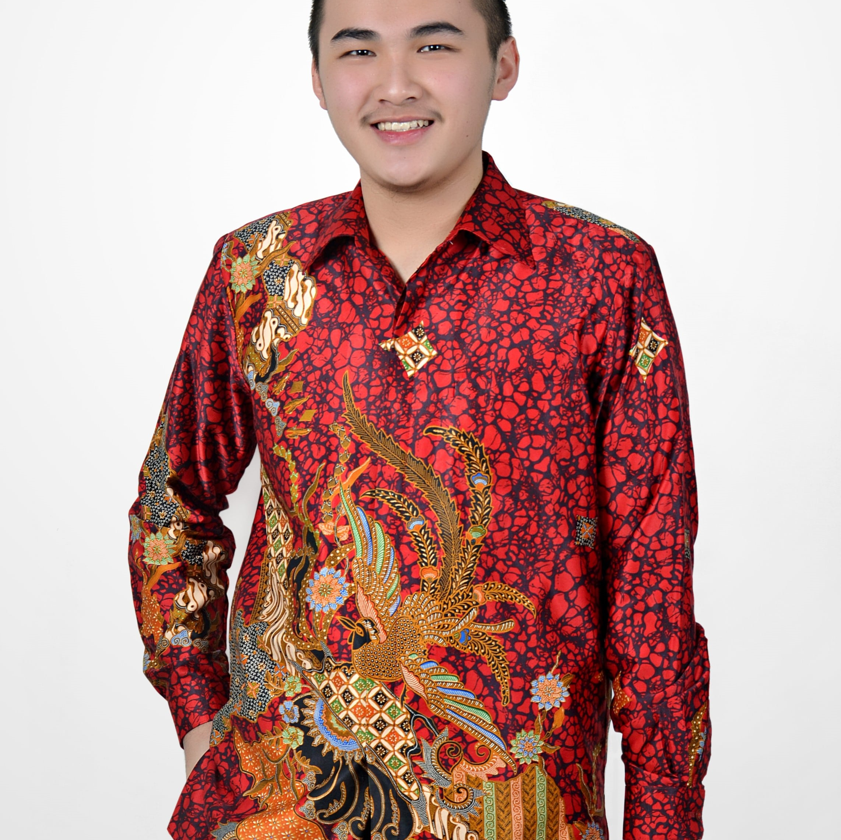
Predict Clicked Ads Customer Classification by using Machine Learning
Created by:
Dharma Setiawan
dharmasetiawan100@gmail.com
www.linkedin.com/in/dharma-setiawan
Dharma is a highly competent Financial Engineer professional with a proven track record in data, finance, and statistic. He has strong technical skills as well as excellent interpersonal skills, enabling him to interact with a wide range of clients. He is eager to be challenged in order to grow and further improve analyzing, technical, and problem- solving skills. His greatest passion is in life is using my technical know-how to benefit other people and organizations.

Slide 2
Overview
“Sebuah perusahaan di Indonesia ingin mengetahui efektifitas sebuah iklan yang mereka tayangkan, hal ini penting bagi perusahaan agar dapat mengetahui seberapa besar ketercapainnya iklan yang dipasarkan sehingga dapat menarik customers untuk melihat iklan.
Dengan mengolah data historical advertisement serta menemukan insight serta pola yang terjadi, maka dapat membantu perusahaan dalam menentukan target marketing, fokus case ini adalah membuat model machine learning classification yang berfungsi menentukan target customers yang tepat ”
Untuk selengkapnya, dapat melihat Google Drive disini

Slide 3
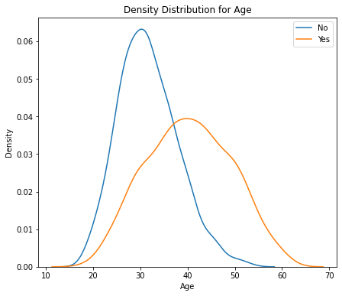
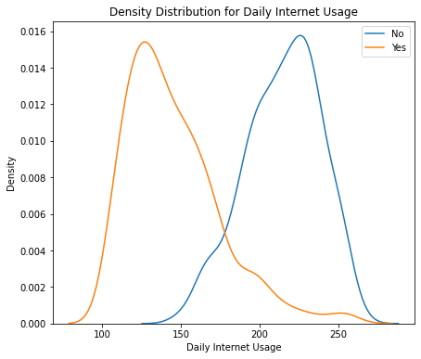
Customer Type and Behaviour Analysis on Advertisement
Customers who are older are more likely to click Ads
Customers who rarely used internet are more likely to click Ads
Untuk selengkapnya, dapat melihat jupyter notebook disini

Slide 4
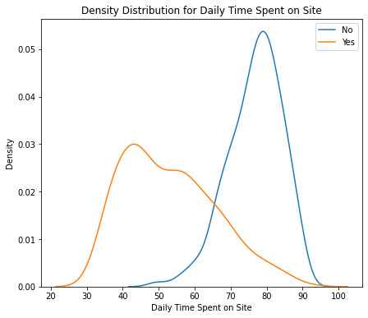
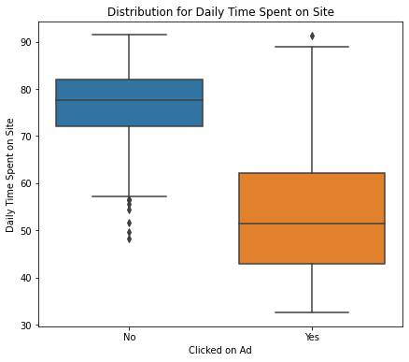
Customer Type and Behaviour Analysis on Advertisement
Customers who rarely used internet are more likely to click Ads
Untuk selengkapnya, dapat melihat jupyter notebook disini

Slide 5
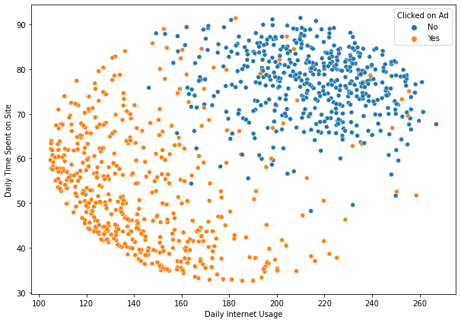
Customer Type and Behaviour Analysis on Advertisement
Bivariate Analysis
Users are segmented into two parts active users and non-active users. From this plot, we can know that we should target the non-active users for better engagement.
Untuk selengkapnya, dapat melihat jupyter notebook disini

Slide 6
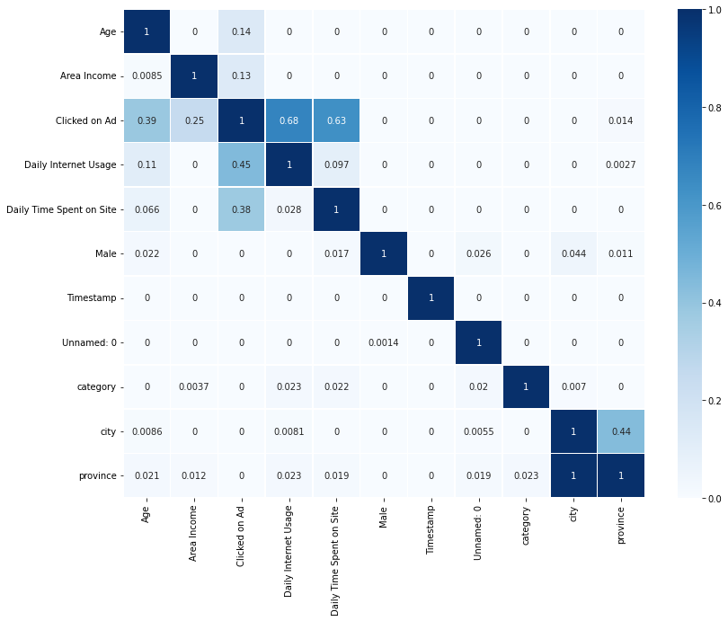
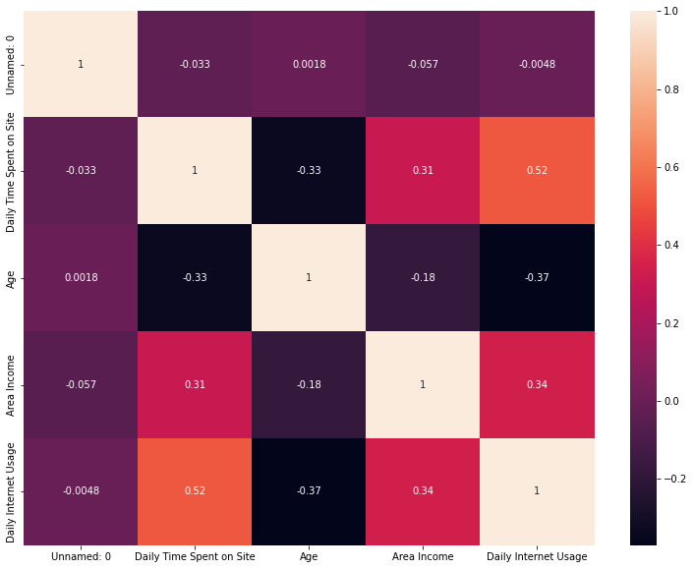
Customer Type and Behaviour Analysis on Advertisement
Correlation
We can use all features for the modeling
Untuk selengkapnya, dapat melihat jupyter notebook disini

Slide 7
Data Cleaning and Preprocessing

Slide 8
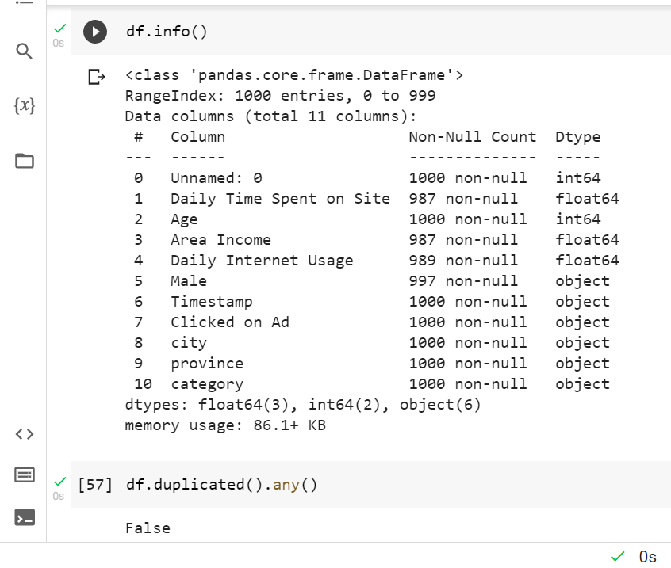
Data Cleaning & Preprocessing
From the code, we know that there is missing value on Daily Time Spent on Site, Area Income, Daily Internet Usage, and Male.
We also know that there is not any duplicated data.
Untuk selengkapnya, dapat melihat jupyter notebook disini

Slide 9
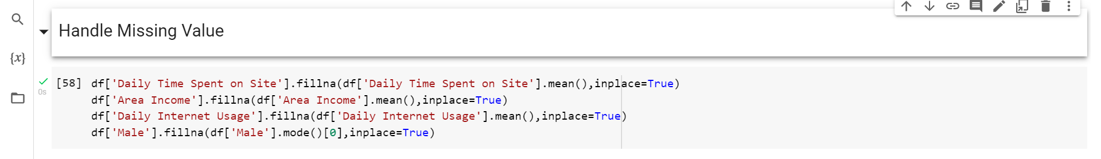
Data Cleaning & Preprocessing
From the code, we will fill our data with:
Daily Time Spent on Site: Mean
Area Income: Mean
Daily Internet Usage: Mean
Male: Mode
Untuk selengkapnya, dapat melihat jupyter notebook disini

Slide 10
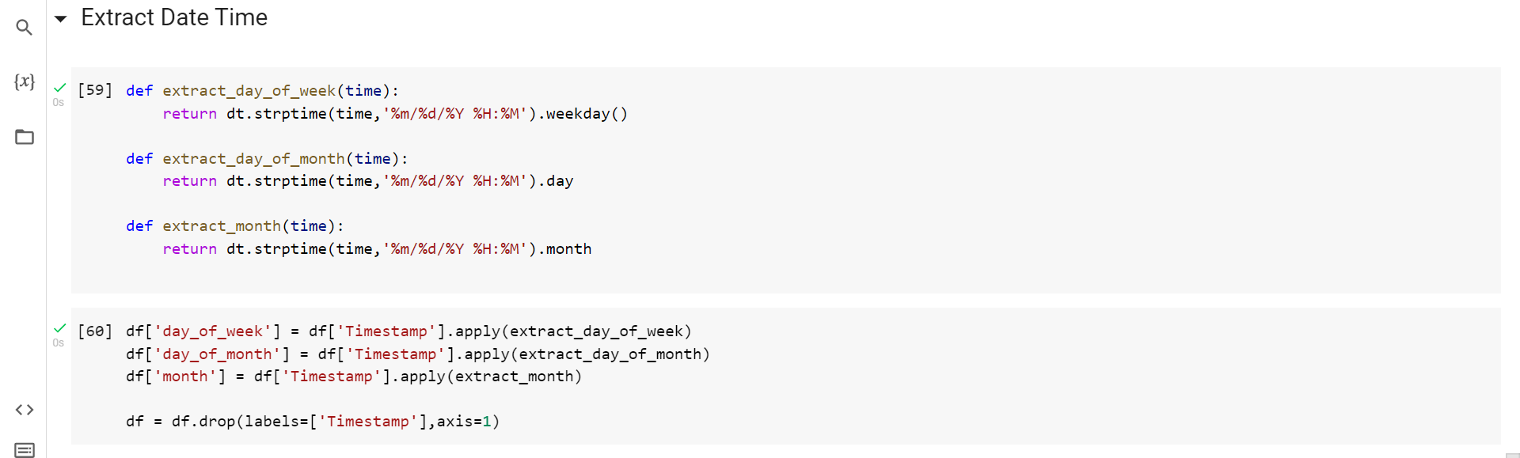
Data Cleaning & Preprocessing
We will fill the Time Stamp by day of week, day of month, and month by using strptime function. This function can change the date into numerical values.
Untuk selengkapnya, dapat melihat jupyter notebook disini

Slide 11
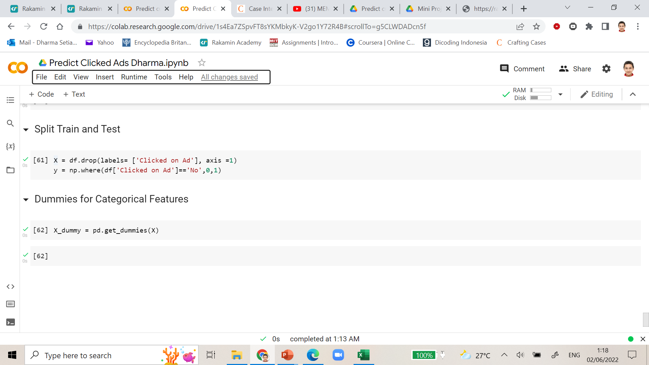
Data Cleaning & Preprocessing
We need to drop Clicked on Ad as our target and use the rest as features
We need to use get dummies so that we can use categorical features for our modeling
Untuk selengkapnya, dapat melihat jupyter notebook disini

Slide 12
Data Modeling

Slide 13
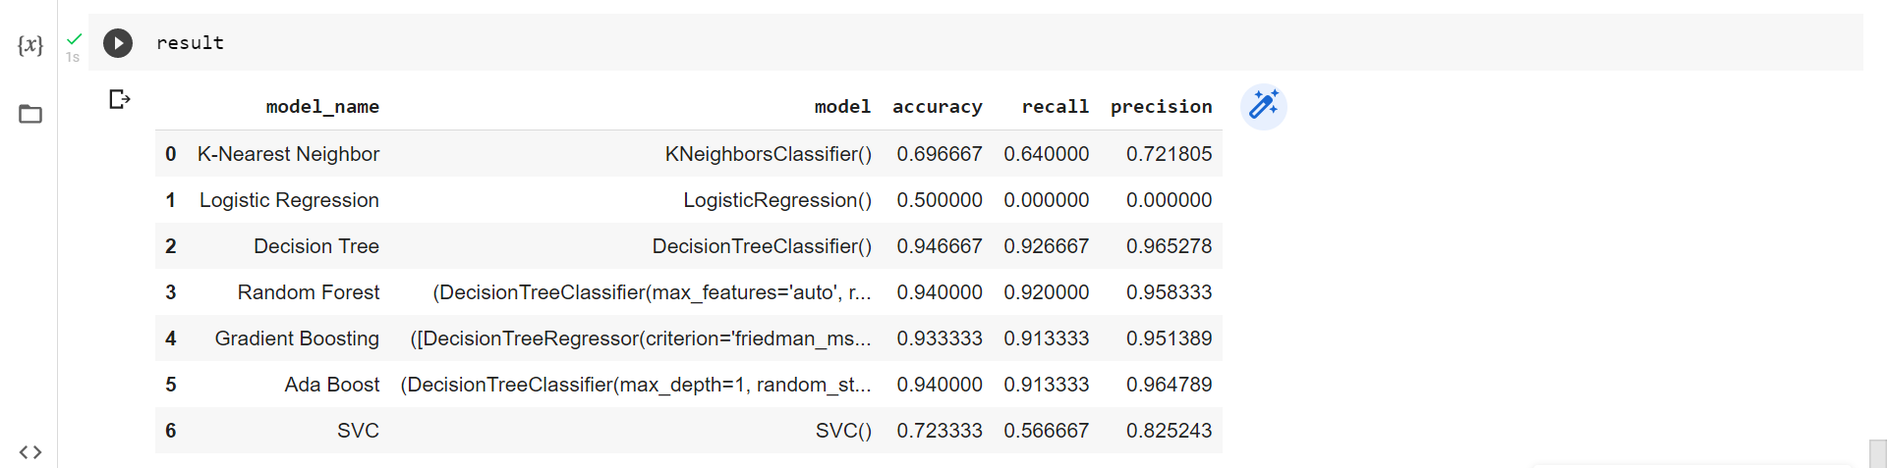
Data Modeling
Experiment 1
Untuk selengkapnya, dapat melihat jupyter notebook disini

Slide 14
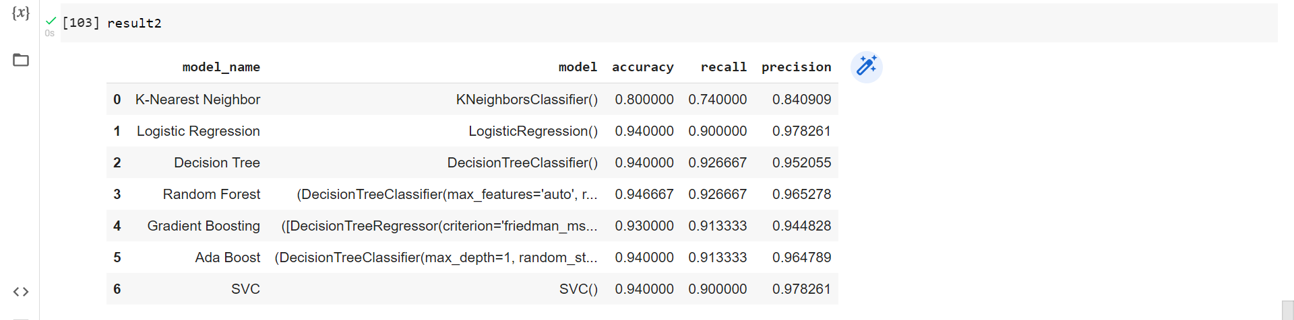
Data Modeling
Data Modeling
Experiment 2

Slide 15
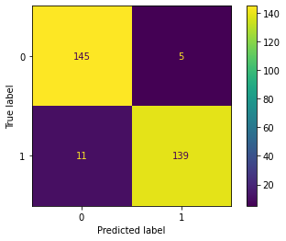
Data Modeling
Confusion Matrix Random Forest

Slide 16
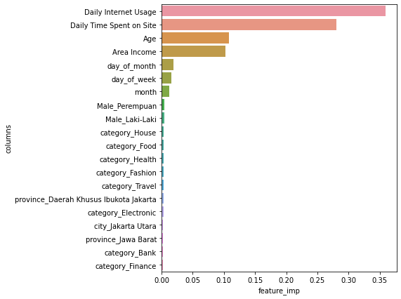
Data Modeling
Features Importance Random Forest
We can know that daily internet usage and daily time spent on site are the important features to predict whether the users will click ads or not.

Slide 17
Business Recommendation & Simulation

Slide 18
Business Recommendation & Simulation
From EDA and feature importance, we can conclude several things:
1. We have 2 kind of users that we can seperate into active and inactive users.
- Active users have criteria use internet often, young age, high salary
- Non active users are the contrary.
2. Users with the low class income are more likely to click the product on digital ads.
3. Users who usually use the internet are more difficult to be our potential users because they are already familiar with digital ads.
4. Older people are our potential users
Business takeaway:
1. We can use soft selling to target the users
2. We can use content mainstream to get the low income people.
Untuk selengkapnya, dapat melihat jupyter notebook disini

Slide 19
Business Recommendation & Simulation
Simulation:
Without Machine Learning Model
We will use our budget averagely 300 * 10,000 = 3M rupiah for advertisment
Cost=3M
Our conversion rate is 50%
We can gain 150 * 12,000 = 1.8M
Revenue=1.8M
Profit=1.8-3=-1.2M
Based on our simulation, if we do not use machine learning model, we will get potential loss: 1.2M rupiah
With Machine Learning Model
We will do the advertisement only for users who potentially clicked the ads (prediction = 1).
We will use the budget around 144 * 10k = 1.44M rupiah to do the advertisement
Cost=1.44jt
Our conversion rate: 139/144 = 96.527%
From 144 users that we predict, there will be 139 users who convert
We will get 139 * 12,000 = 1.668jt
Revenue=1.668jt
Profit=1.668-1.46=228k
From the simulation, if we use machine learning we will get potential revenue: 228k rupiah
Untuk selengkapnya, dapat melihat jupyter notebook disini

